Slide 1
sales and revenue perfmoance event work
https://app.powerbi.com/links/wvG1aHuJ4q?ctid=667edd27-c714-4021-a446-fce6b0e8ec41&pbi_source=linkShare

Slide 2



1001- ashok chitkireddy
View in Power BI
Last data refresh:
1/2/2026 1:35:18 PM UTC
Downloaded at:
1/2/2026 1:42:19 PM UTC

Slide 3
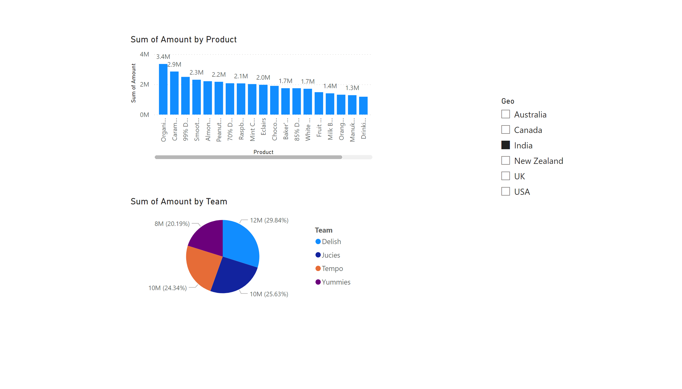
Page 1
Notes:
clusteredColumnChart
No alt text provided
pieChart
No alt text provided
slicer
No alt text provided

Slide 4
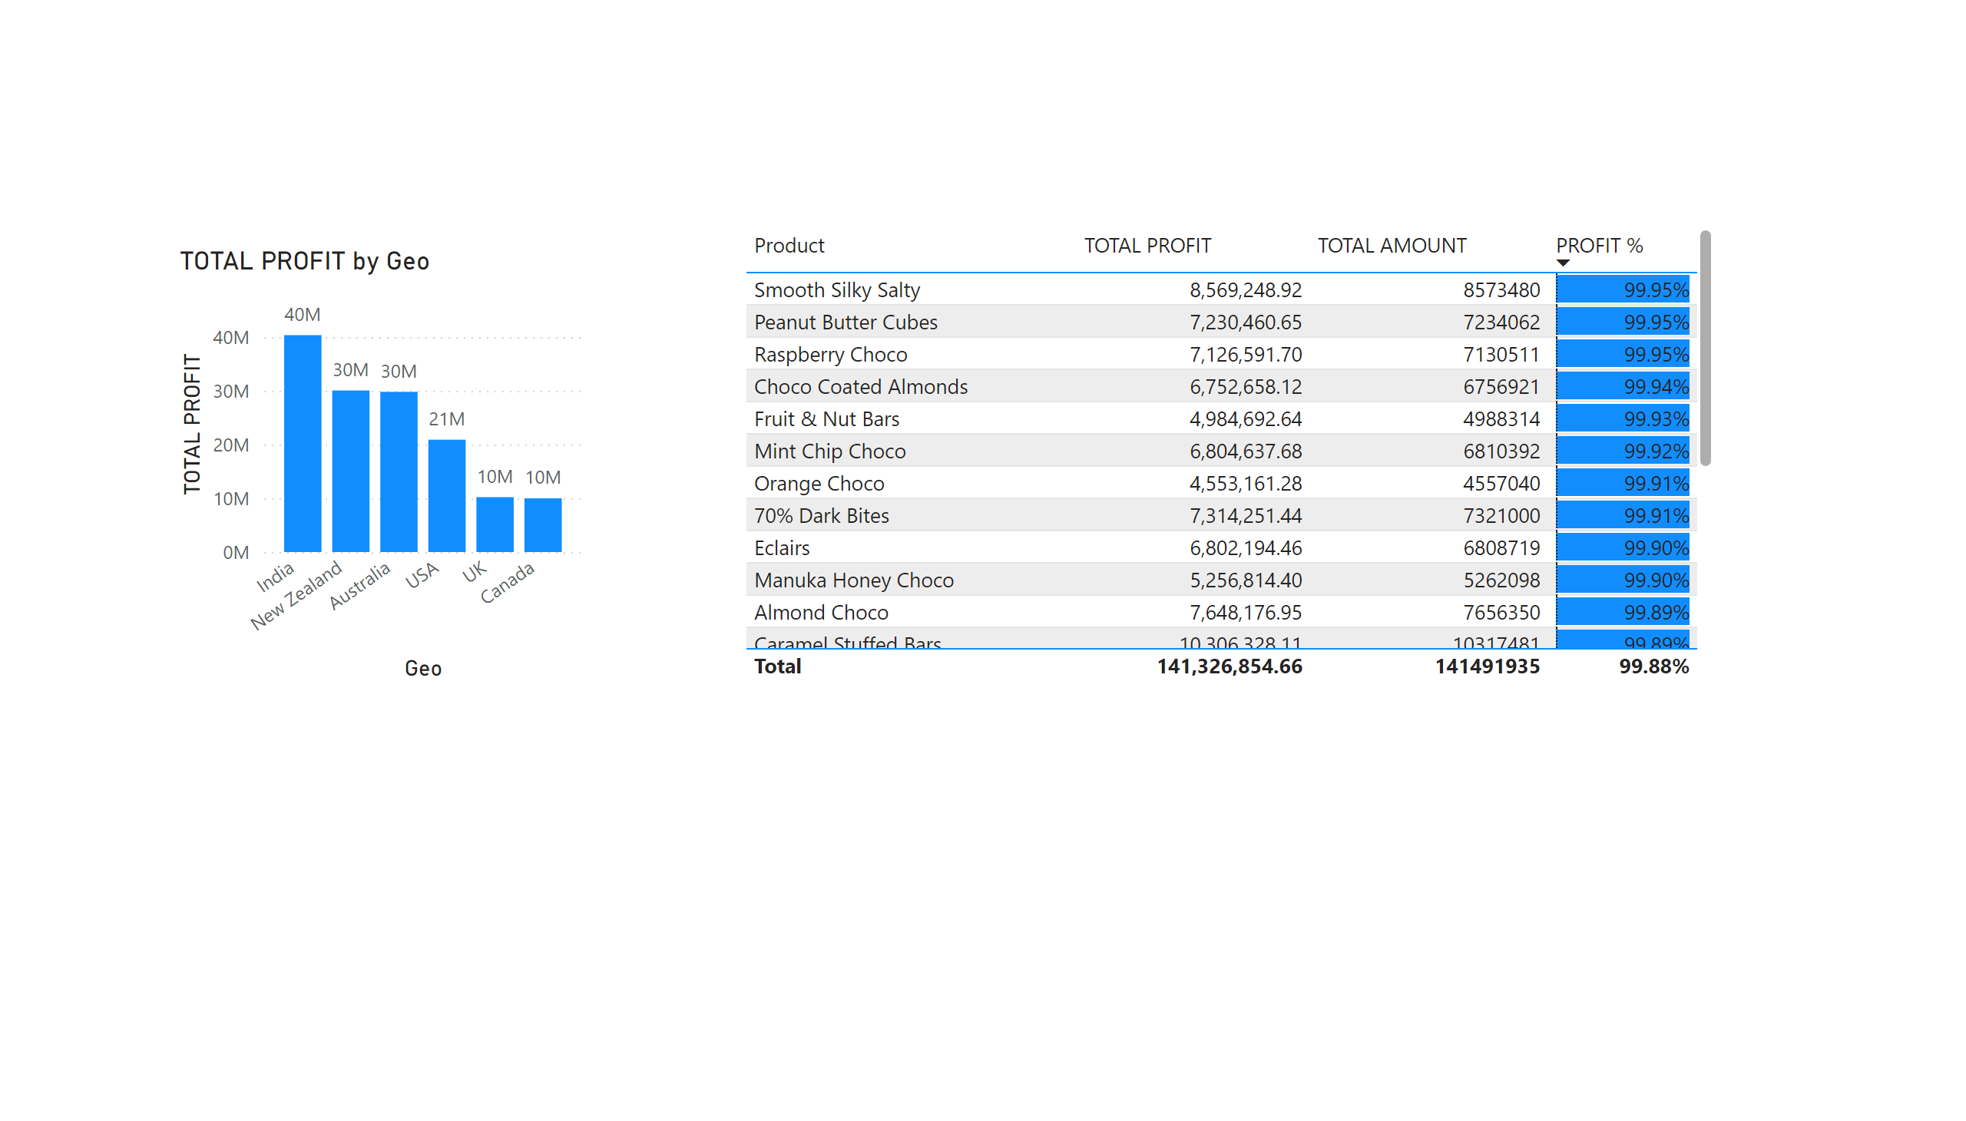
Page 2
Notes:
tableEx
No alt text provided
clusteredColumnChart
No alt text provided

Slide 5
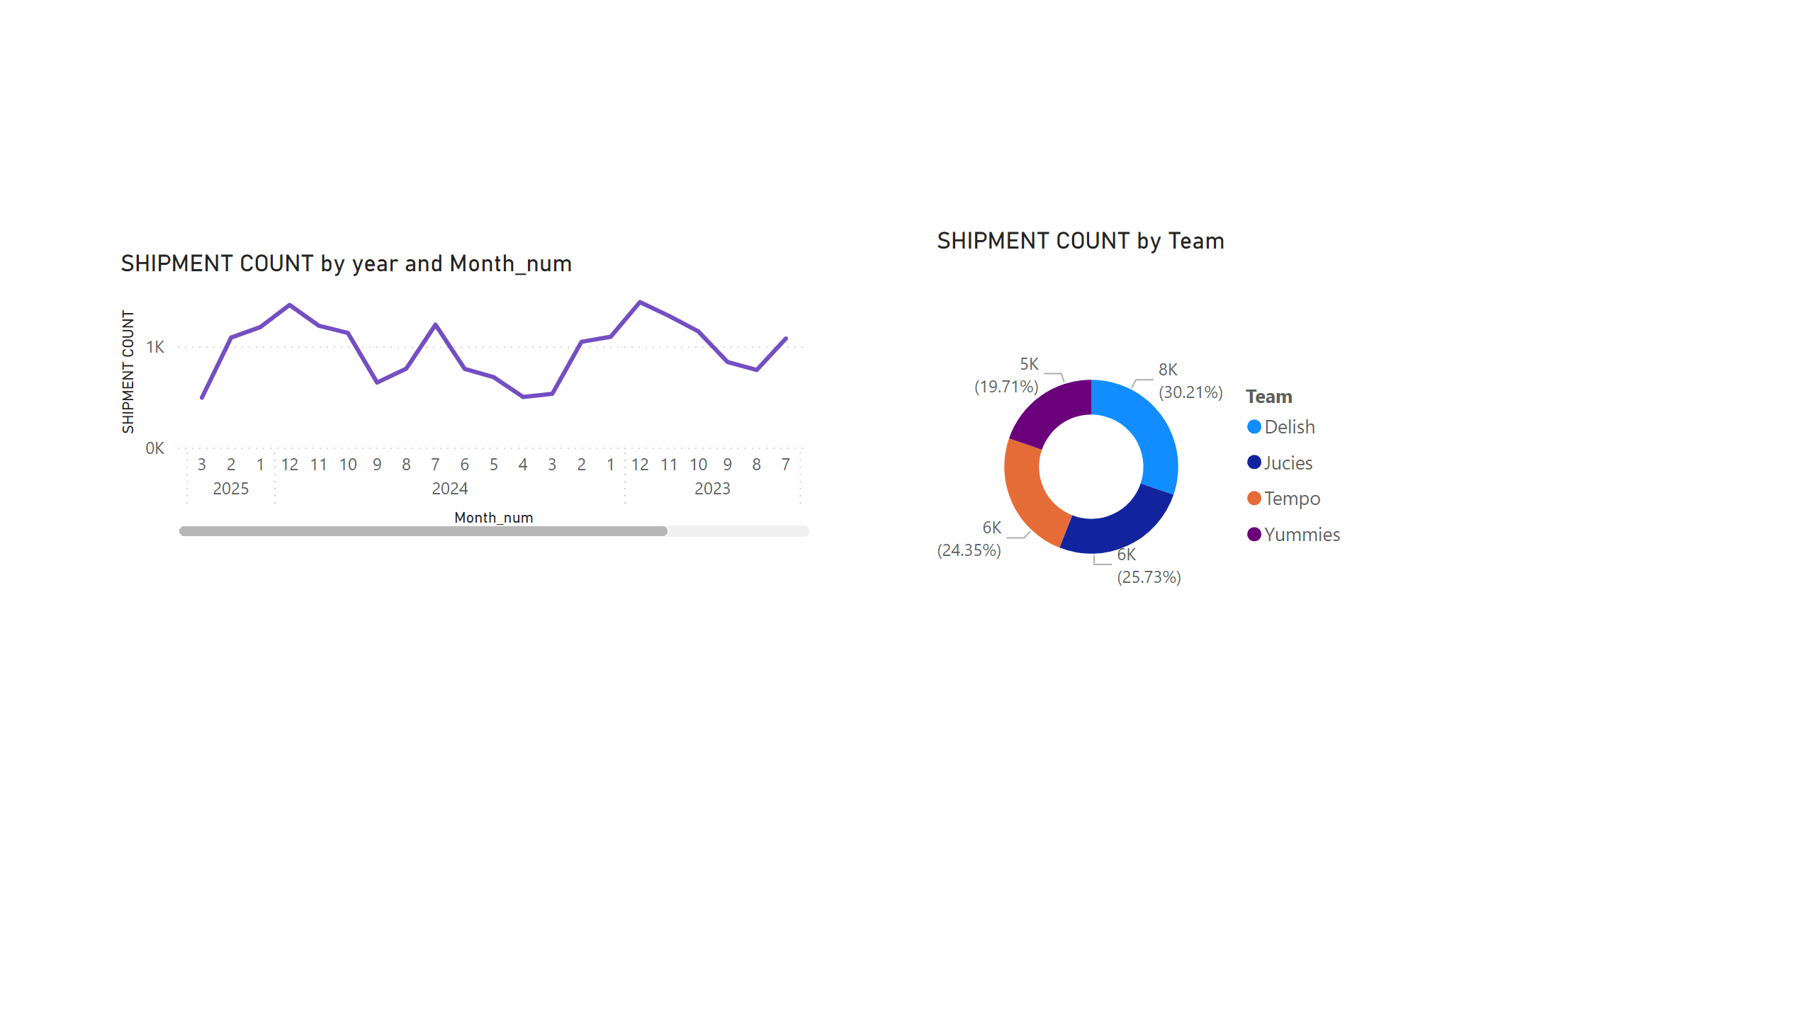
Page 3
Notes:
lineChart
No alt text provided
donutChart
No alt text provided

Slide 6
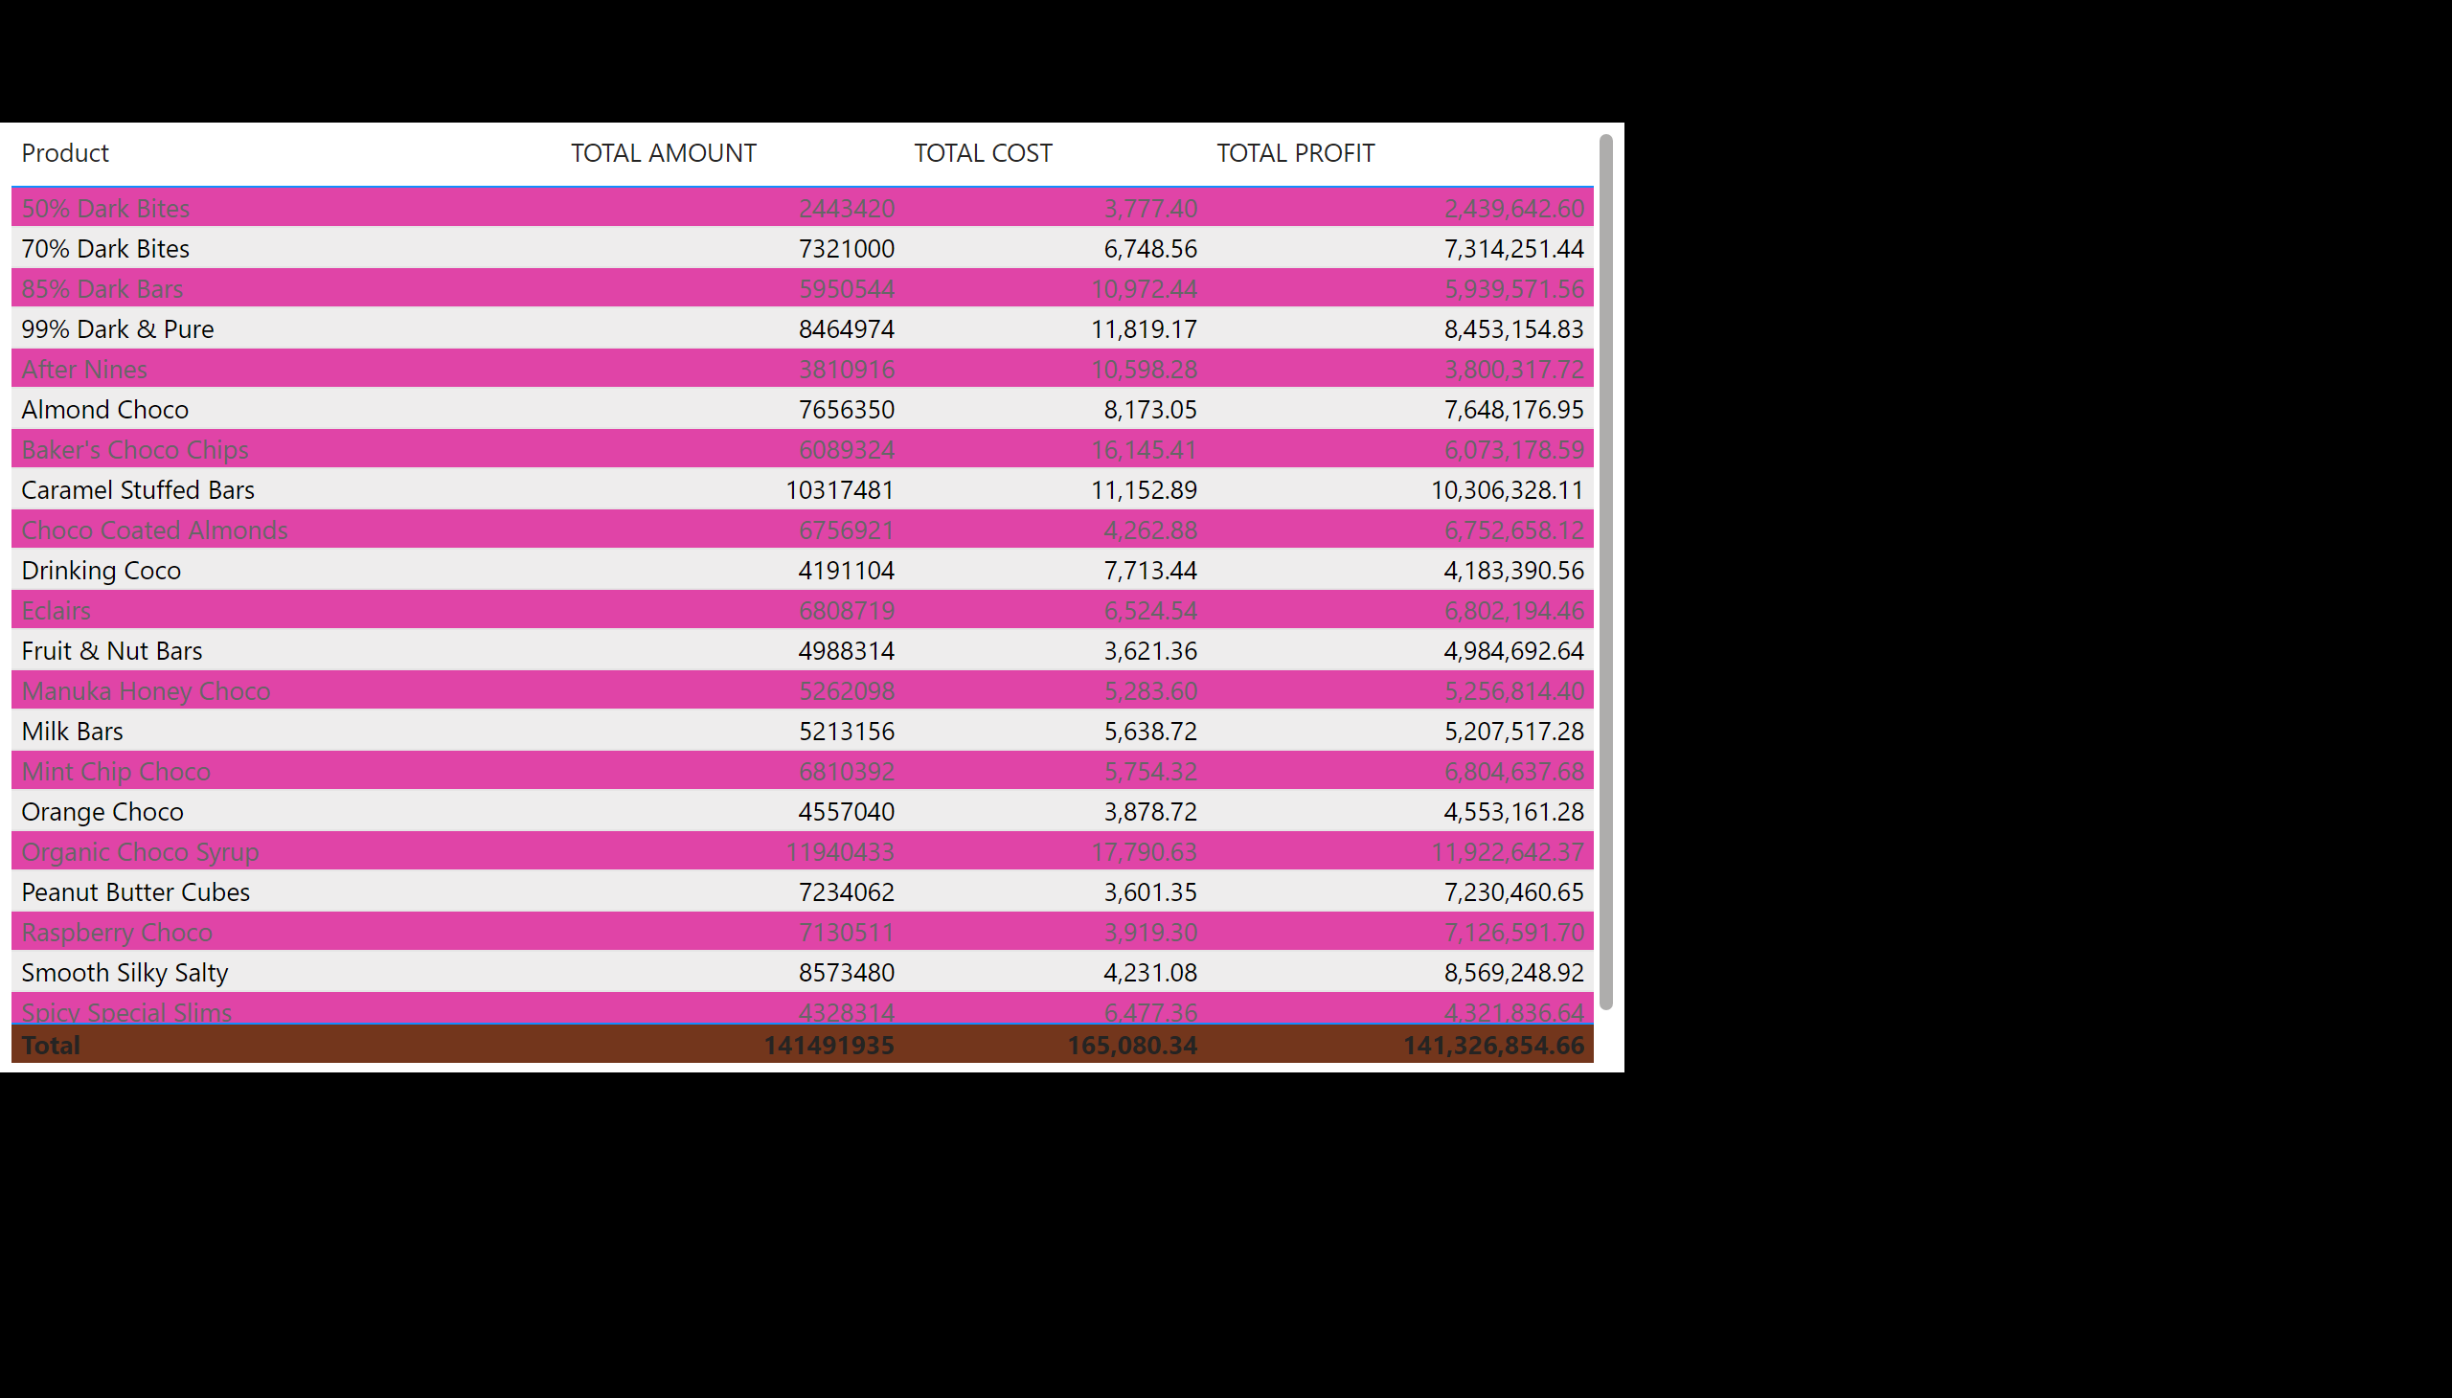
Page 4
Notes:
tableEx
No alt text provided

Slide 7
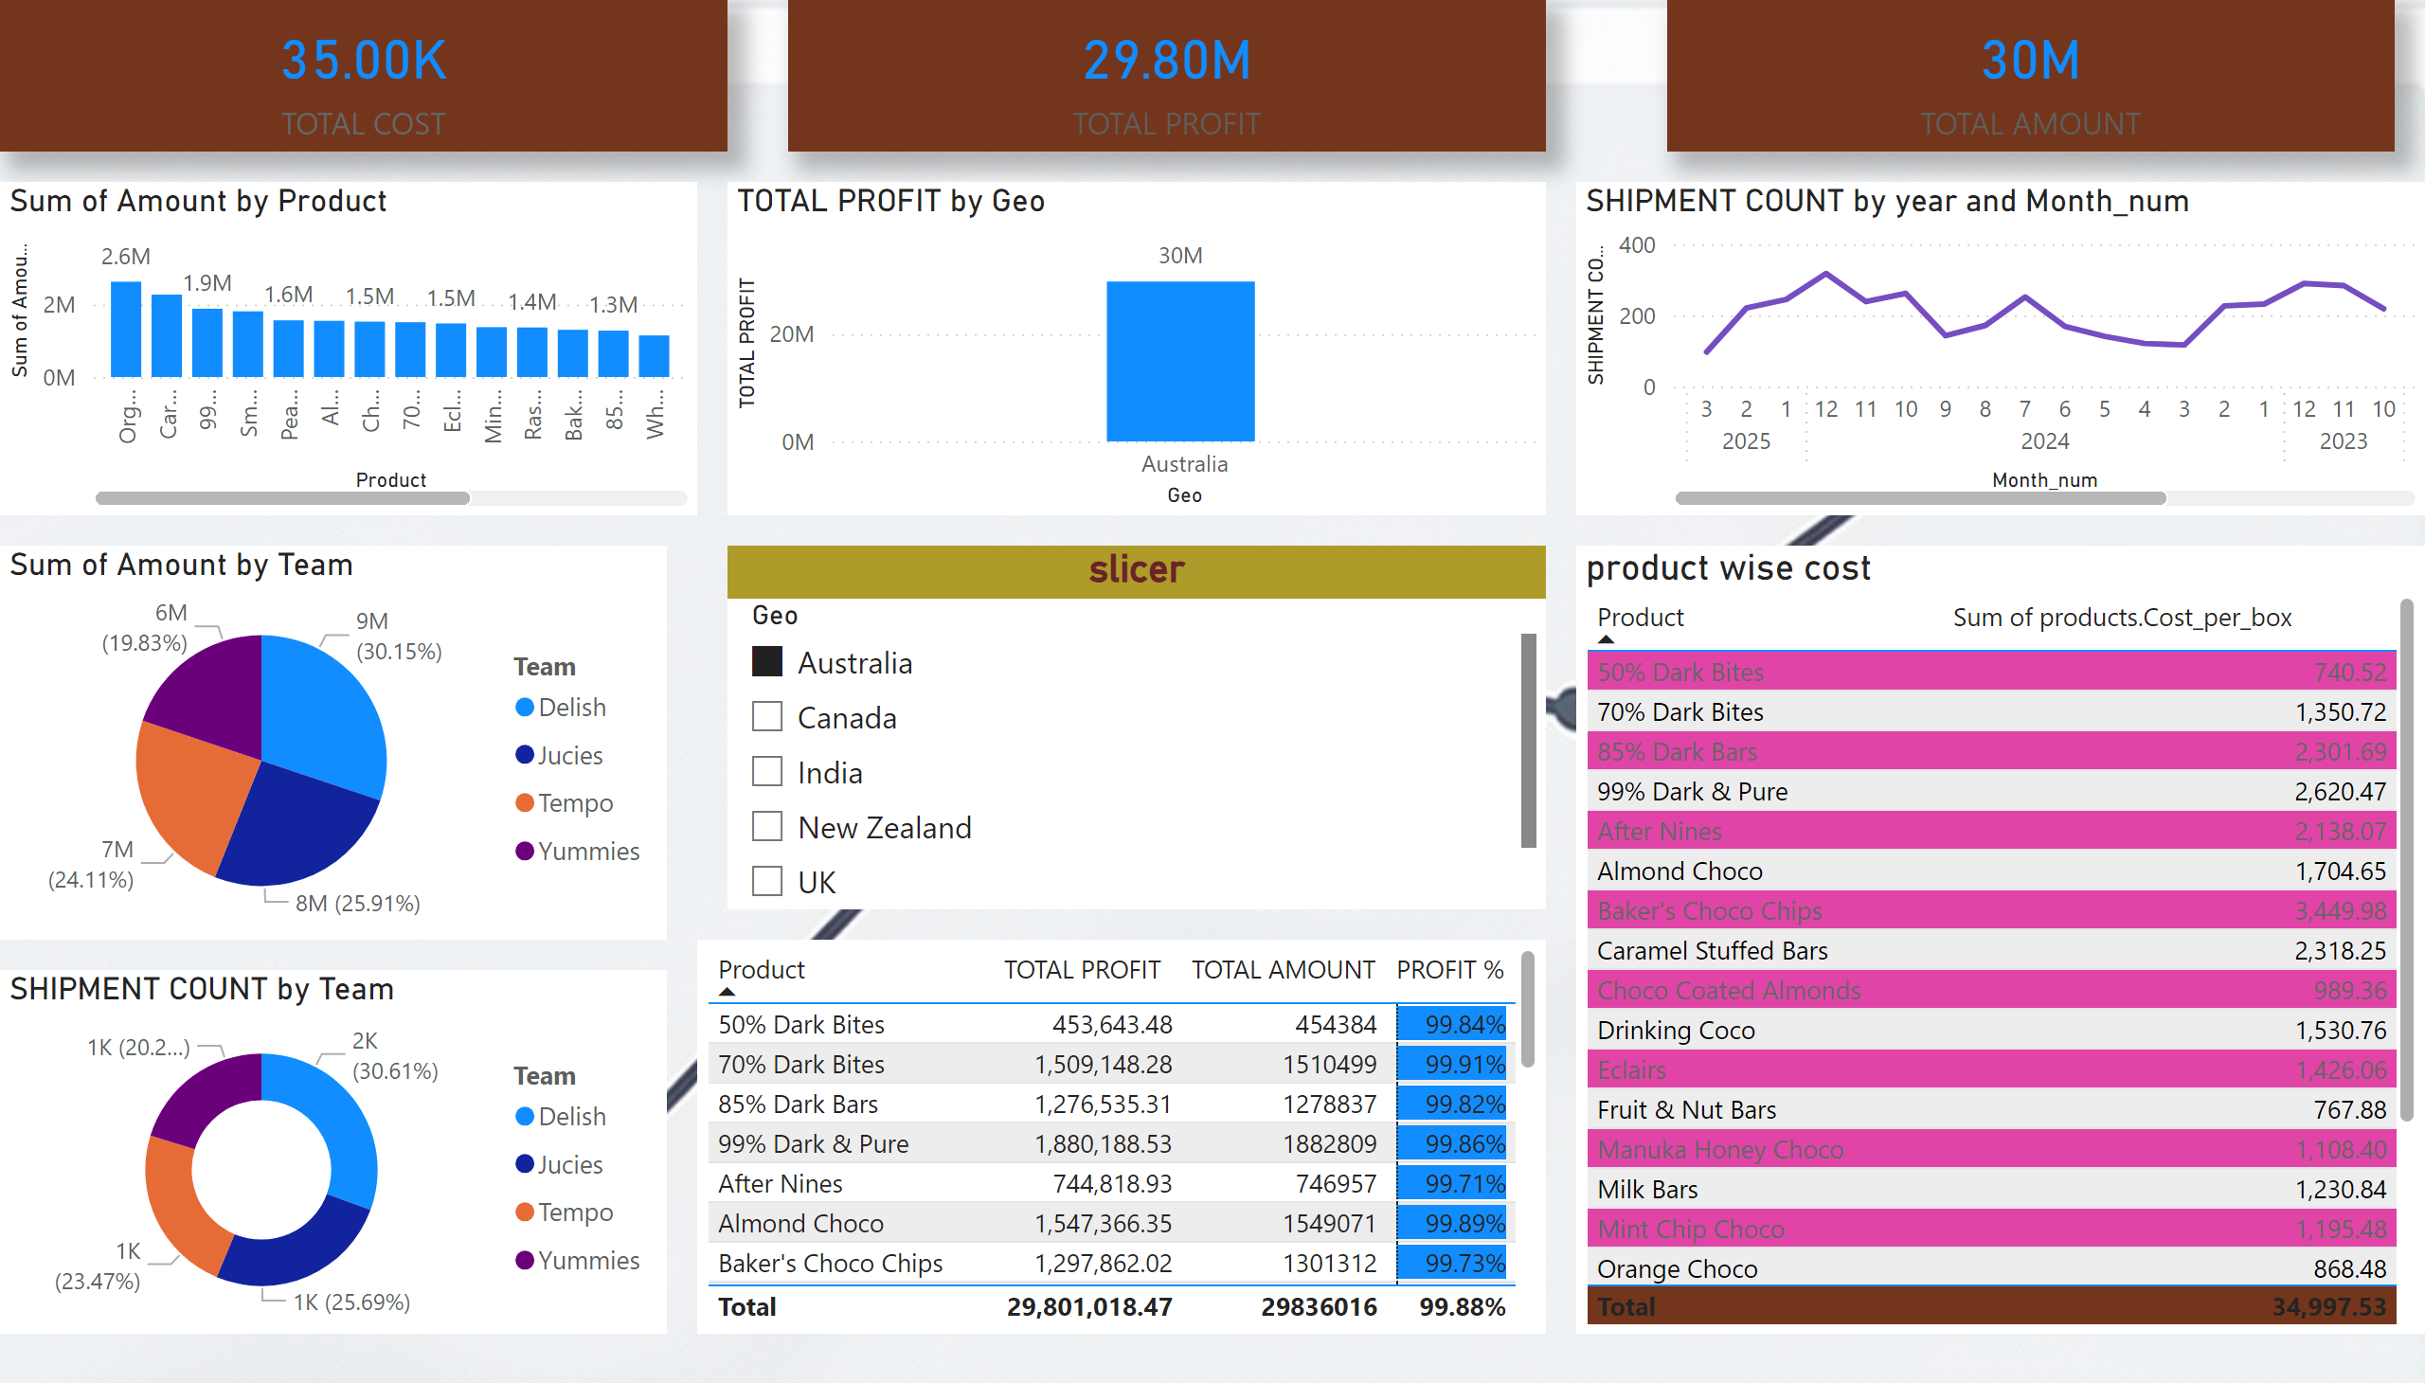

sales & revenue
Notes:
slicer
No alt text provided
tableEx
No alt text provided
card
No alt text provided
clusteredColumnChart
No alt text provided
card
No alt text provided
card
No alt text provided
donutChart
No alt text provided
product wise cost
No alt text provided
lineChart
No alt text provided
clusteredColumnChart
No alt text provided
pieChart
No alt text provided

